Slide 1
ATAI
Advanced Technique of Artificial Intelligence
ATAI
ChongqingUniversity _{AdvancedTechniqueof}
of Technology Artificial Intelligence
Chongqing University of Technology
Chongqing University ^{ATAI}
_{of Technology} Advanced Techniqueof
Artificial Intelligence
Chongqing University of Technology
Chongqing University of Technology
2025_AAAI_Re2LLM_Reflective Reinforcement Large Language Model for Session-based Recommendation
code:None
——AAAI’25
Reported by Jinfei Chen
1

Slide 2
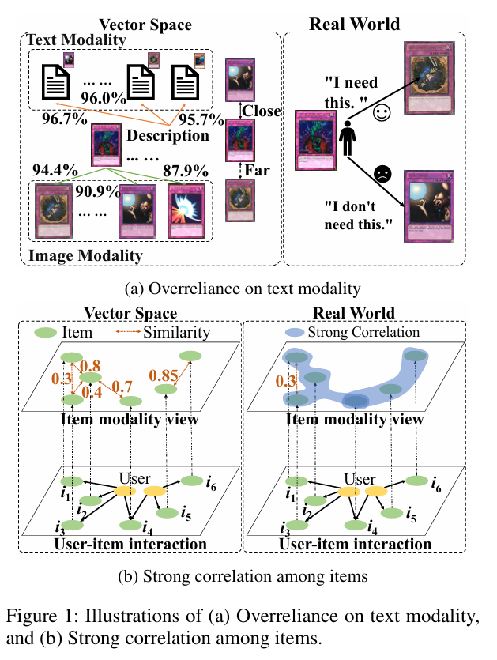
ATAI
Advanced Technique of
Artificial Intelligence
ATAI
ChongqingUniversity _{AdvancedTechniqueof}
of Technology Artificial Intelligence
Chongqing University of Technology
Motivation
The significance of multimodal side information is uneven. This indicates that item features mainly learn along the side of higher text similarity in the item homogeneous graph.
Relying solely on the propagation of item similarity adjacency in the vector space of item features poses challenges in fully addressing users’ diverse needs.

Slide 3
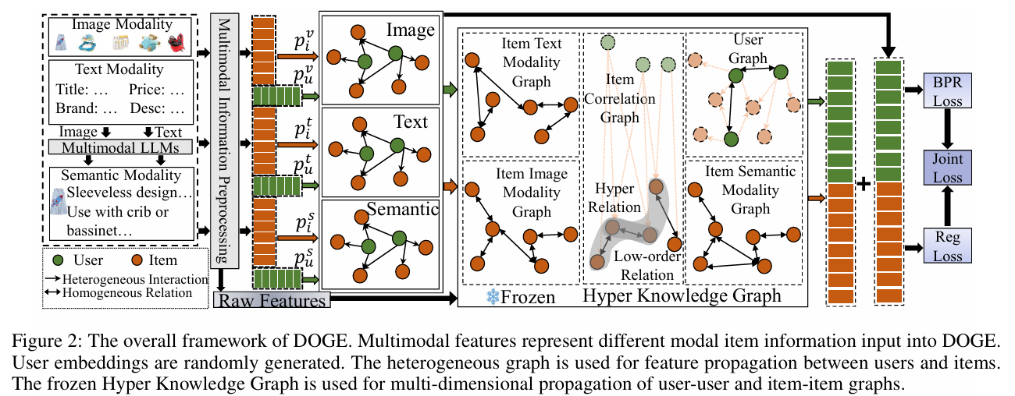
ATAI
Advanced Technique of
Artificial Intelligence
ATAI
ChongqingUniversity _{AdvancedTechniqueof}
of Technology Artificial Intelligence
Chongqing University of Technology
Overview

Slide 4
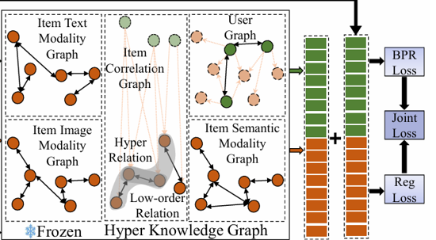
ATAI
Advanced Technique of
Artificial Intelligence
ATAI
ChongqingUniversity _{AdvancedTechniqueof}
of Technology Artificial Intelligence
Chongqing University of Technology
Method

Slide 5
ATAI
Advanced Technique of
Artificial Intelligence
ATAI
ChongqingUniversity _{AdvancedTechniqueof}
of Technology Artificial Intelligence
Chongqing University of Technology
Method

Slide 6
ATAI
Advanced Technique of
Artificial Intelligence
ATAI
ChongqingUniversity _{AdvancedTechniqueof}
of Technology Artificial Intelligence
Chongqing University of Technology
Method

Slide 7
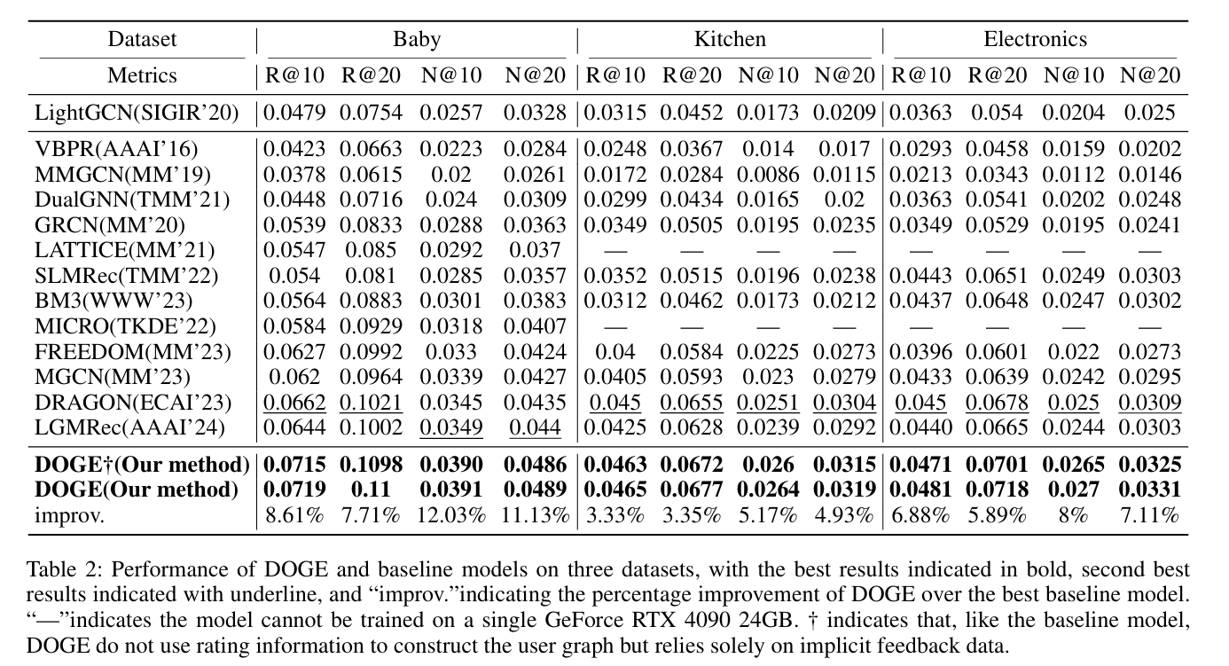
ATAI
Advanced Technique of
Artificial Intelligence
ATAI
ChongqingUniversity _{AdvancedTechniqueof}
of Technology Artificial Intelligence
Chongqing University of Technology
Experiments

Slide 8
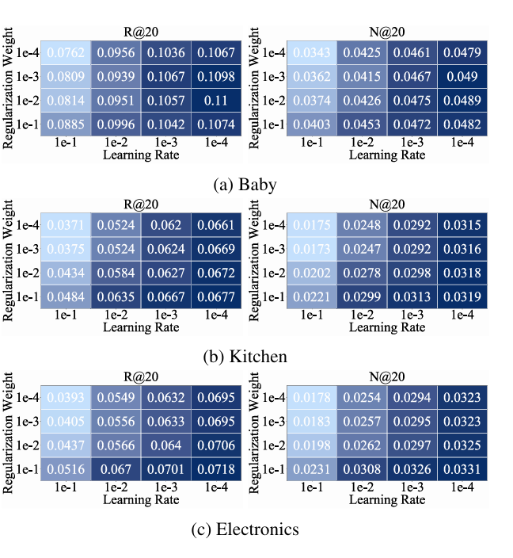
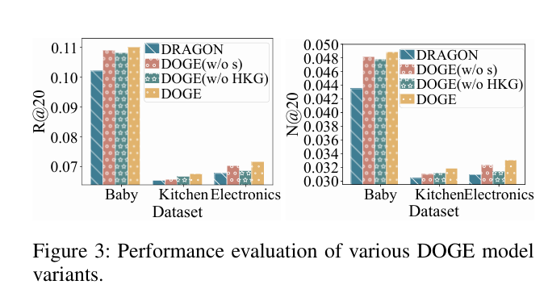
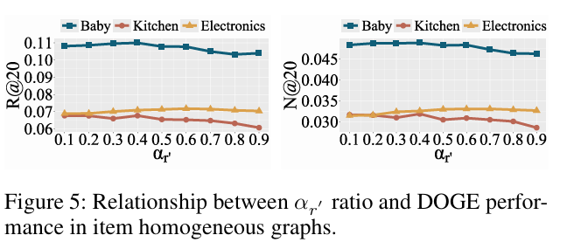
ATAI
Advanced Technique of
Artificial Intelligence
ATAI
ChongqingUniversity _{AdvancedTechniqueof}
of Technology Artificial Intelligence
Chongqing University of Technology
Experiments

Slide 9
ATAI
Advanced Technique of
Artificial Intelligence
ATAI
ChongqingUniversity _{AdvancedTechniqueof}
of Technology Artificial Intelligence
Chongqing University of Technology
Experiments

Slide 10
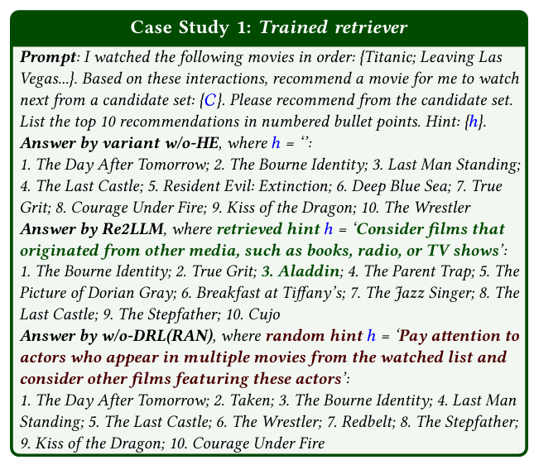
ATAI
Advanced Technique of
Artificial Intelligence
ATAI
ChongqingUniversity _{AdvancedTechniqueof}
of Technology Artificial Intelligence
Chongqing University of Technology
Experiments
Notes:
情形一（Case 1）
在这种情况下，LLM 主干模型在没有提示信息（即 w/o-HE 变体）时无法命中目标物品。 而 Re2LLM 中训练好的检索代理能够成功检索到定制化的提示信息，并在 Top-10 推荐列表中将目标物品命中在第3位，这证明该代理能够通过任务反馈学习有效提示。 相比之下，w/o-DRL（RAN）使用随机提示，由于提示不相关，无法正确预测目标物品。
情形二（Case 2）
在这种情况下，LLM 主干模型即使在没有提示的情况下（w/o-HE），也能命中目标物品。 此时，Re2LLM 中训练好的代理进一步提升了推荐质量，将目标物品从 Top-3 提升到了第1位，表现出强化引导作用。 然而，w/o-DRL（RAN）中的随机提示反而起到了负面影响：LLM 原本能正确推荐目标物品，但被误导关注于电影的“发行年份”等无关特征，导致推荐错误。 例如，该 session 偏好喜剧片，但提示内容强调了制作年份，导致模型偏离真正的兴趣点。

Slide 11
ATAI
Advanced Technique of
Artificial Intelligence
ATAI
ChongqingUniversity _{AdvancedTechniqueof}
of Technology Artificial Intelligence
Chongqing University of Technology
Thanks!

